Slide 1

SAP BTP Development framework(C.A.P) CAP ➔ Cloud Application Programming
Jungwoo Han
Digital Platform
SAP Korea

Slide 2
Cloud native 개발 프레임워크, CAP (Cloud Application Programming)
BTP Cloud native 개발 프레임워크인 BTP CAP(Cloud Application Programming)에 대한 이해와 주요 시나리오를 실습합니다. 이 과정을 통해, 참석자는 어플리케이션 개발 프레임워크를 이해하고, BTP 상에서 Microservice Application 구성, Multitenancy등을 실습할 수 있습니다.
■ SAP CAP Hands-On 워크샵 아젠다 및 일정표 (Day 1)
주 제 | 상세 내용 | 시간 | 기술 워크샵 사용 환경 | 참석자 준비 사항
1. SAP BTP Update | SAP BTP 최신 기능 Update | 09:00~09:30(30분) | PPT 설명 | 노트북 지참 (Chrome 브라우저 사용)
2. CAP Overview | BTP CAP framework 소개 및 데모 Hands-on을 위한 준비 확인 | 09:30~10:30(60분) | PPT 설명
Break time |  | 10:30~10:50(20분)
3. Hands-on | 서비스 Provider 로서의 CAP 기능 Business Logic to UI까지 Full-stack 개발 | 10:50~12:00(70분) | PPT 설명, Demo & Hands-0n
Lunch |  | 12:00~13:20(80분)
4. Hands-on | 서비스 Consumer로서의 CAP 기능 S/4HANA Public Cloud 와의 Mesh-up 개발 ➔ 외부 external 서비스로 대체. 개발 및 작동 원리는 유사. | 13:20~15:00(100분) | PPT 설명, Demo & Hands-on
Break time |  | 15:00~15:20(20분)
4. Wrap-up & QA | Hands-on에 사용된 BTP 기능 상세 소개 및 Hands-on 완성. | 15:20~16:20(60분) | PPT 설명, Demo & Hands-on

Slide 3







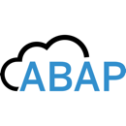











SAP BTP의 애플리케이션 주요 개발 서비스
애플리케이션 개발, 프로세스 자동화, 디지털 경험 서비스
현업 사용자
Qualtrics Customer Insights
UI / UX
SAP UI5
Build Apps
Build WorkZone ADV
Build WorkZone STD (Fiori Launchpad)
Service / Modeling
SAP S/4HANA
SAP SuccessFactors
SAP Fieldglass
SAP Concur
SAP Ariba
CAP CDS
ABAP Environment (OData)
업무 전문가 비즈니스 분석가
Data Base
HANA Cloud
PostgreSQL
인증
통합
CI/CD
기능
개발자
Identity Authentication
Integration Suite
Business Application Studio
CI/CD
Transport Management
Process Automation
Document Management
Adobe Forms
3rd-party software
Microsoft Azure
TM
Amazon AWS
TM
Google Cloud
TM

Slide 4
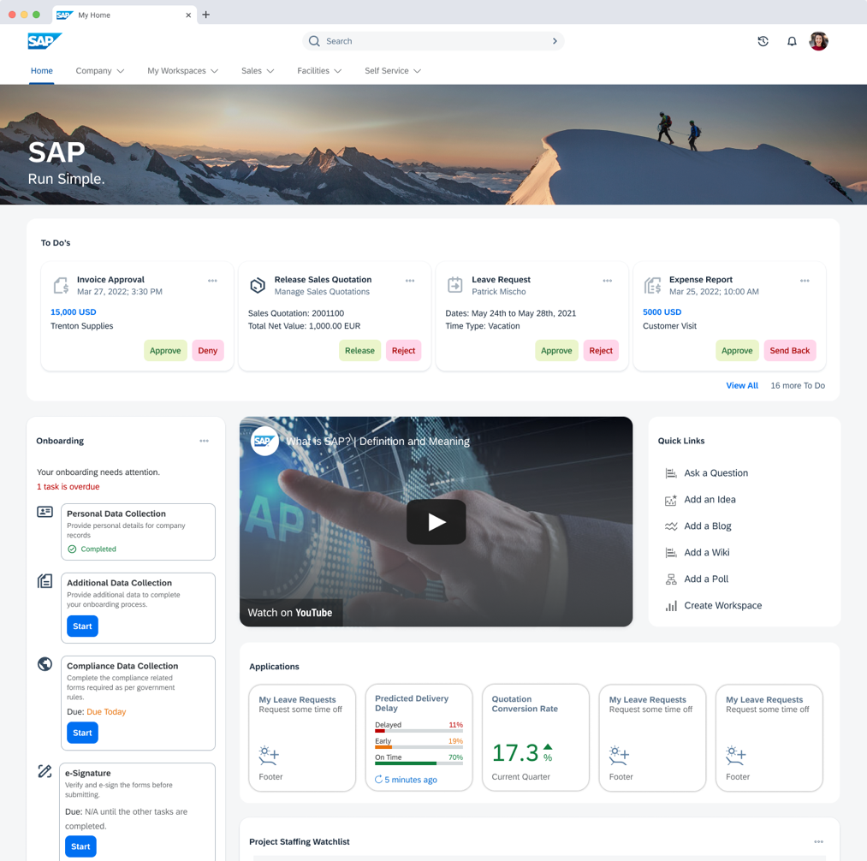
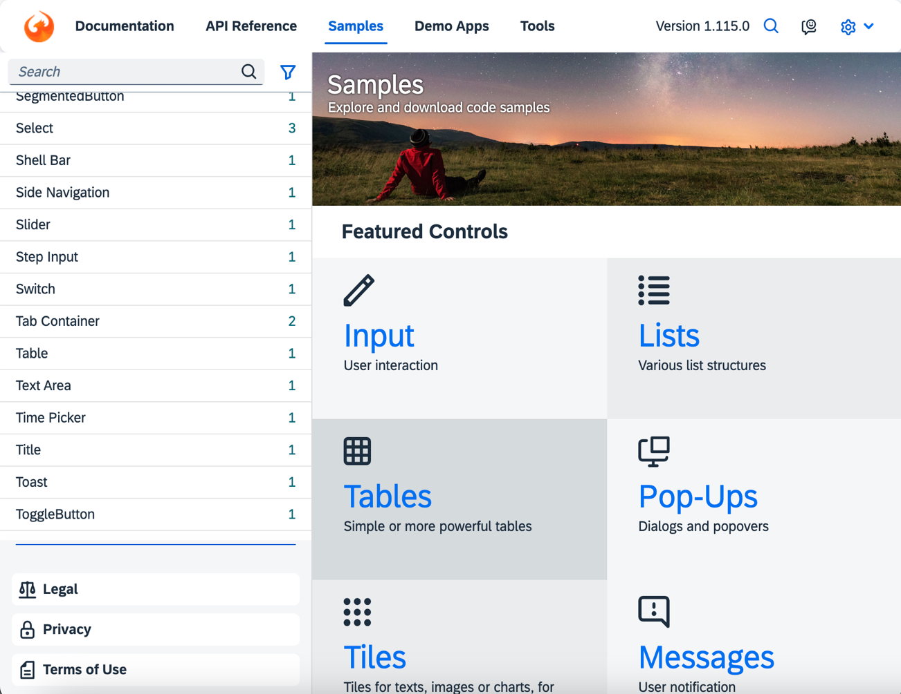
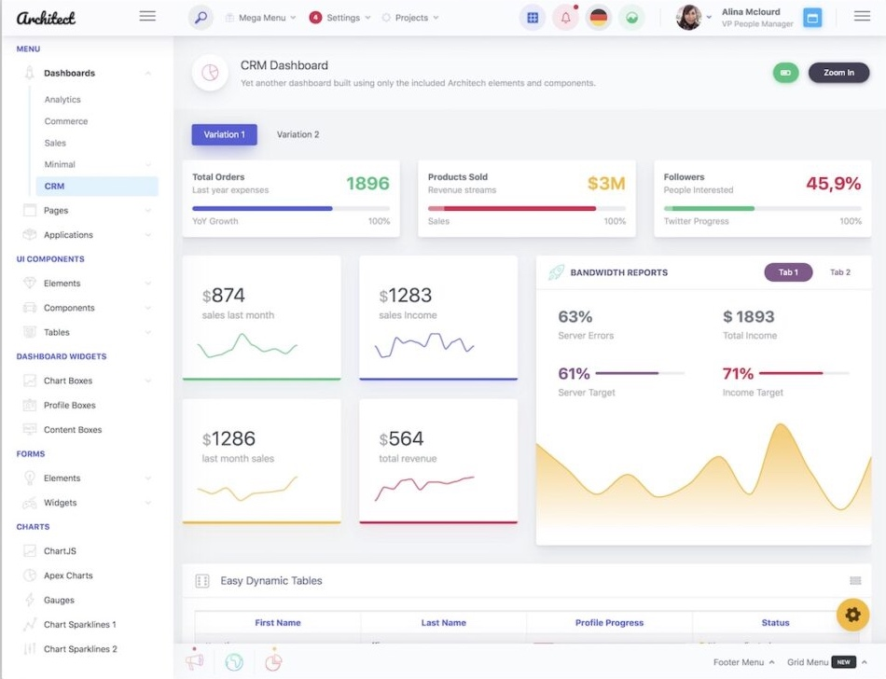
BTP 기반 시스템 구축의 3가지 방안
BTP 시스템 구축
SAP Build WorkZone
(기본 세팅)
UI5 / Fiori FreeStyle 확장
(처음부터 구축)
Lift & Shift 3rd-Parties Porting
(시스템 재사용)
Notes:
1. 기본 시스템을 만들어 놓고 시작
2. 처음부터 시작
3. 쓰던걸 부어서 시작

Slide 5

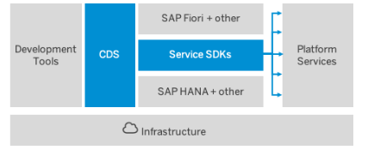
About CAP​
Introducing the Cloud Application Programming Model (CAP)
June 5 2018
https://cap.cloud.sap/docs/about/
The SAP Cloud Application Programming Model (CAP) is a framework of languages, libraries, and tools for building enterprise-grade services and applications. It guides developers along a 'golden path' of proven best practices and a great wealth of out-of-the-box solutions to recurring tasks.
CAP-based projects benefit from a primary focus on domain. Instead of delving into overly technical disciplines, we focus on accelerated development and safeguarding investments in a world of rapidly changing cloud technologies.
Daniel Hutzel

Slide 6
BTP의 Cloud Application Programming 프레임워크
Lock In 없는 Agnostic 디자인
Opinionated Guidance, but Open
개발
도구
CDS
(Core
Data
Service)
Fiori +
Services
CDS에 기반한 Biz Domain 중심
Service SDKs
검증된 Best Practices, Served Out of the Box (Request 처리, 반복 Tasks 등)
SAP HANA +
Dynamic Querying & Views (Core Query Language, Queries as first order Objects 등)
Infrastructure
Service와 이벤트 중심
Node JS
Express
JAVA
Spring
Jumpstart & Grow as you go
Notes:
https://cap.cloud.sap/docs/about/
--no lock-in, don’t take care of low-level technologies
Platform-specific deployment approaches and techniques
Platform-specific identity providers and authentication strategies
On/Off-boarding of tenants in SaaS solutions and tenant isolation
Synchronous protocols like REST, OData, or GraphQL ¹
Asynchronous channels and brokers like SAP Event Mesh, MQ, or Kafka ¹
Different database technologies including SQL and NoSQL

Slide 7

BTP 개발 프레임워크 – CAP > 특징
Fiori Uis를 위한 API제공
OData v2 + v4
Draft 기능 지원
$batch support, …
Services 제공
CDS를 활용한 서비스 정의
Service Providers 역할 수행
Custom 개발 영역 (Event Handlers → generic + custom)
서비스간 이벤트 호출 (Emitting Events)
UIs
UIs
UIs
Services
Services
Services
Data
Data
Data
외부 Services 활용
외부 OData스펙(edmx) 정보를 기반으로 서비스 정의
로컬서비스와 외부서비스간의 Mash-ups
Service Client APIs 자동 생성
데이타 베이스 지원(Runtime시 Database artifact 생성)
Out-of-the-box: HANA, SQLite
Dynamic Data Access layers 지원(cds.ql)

Slide 8
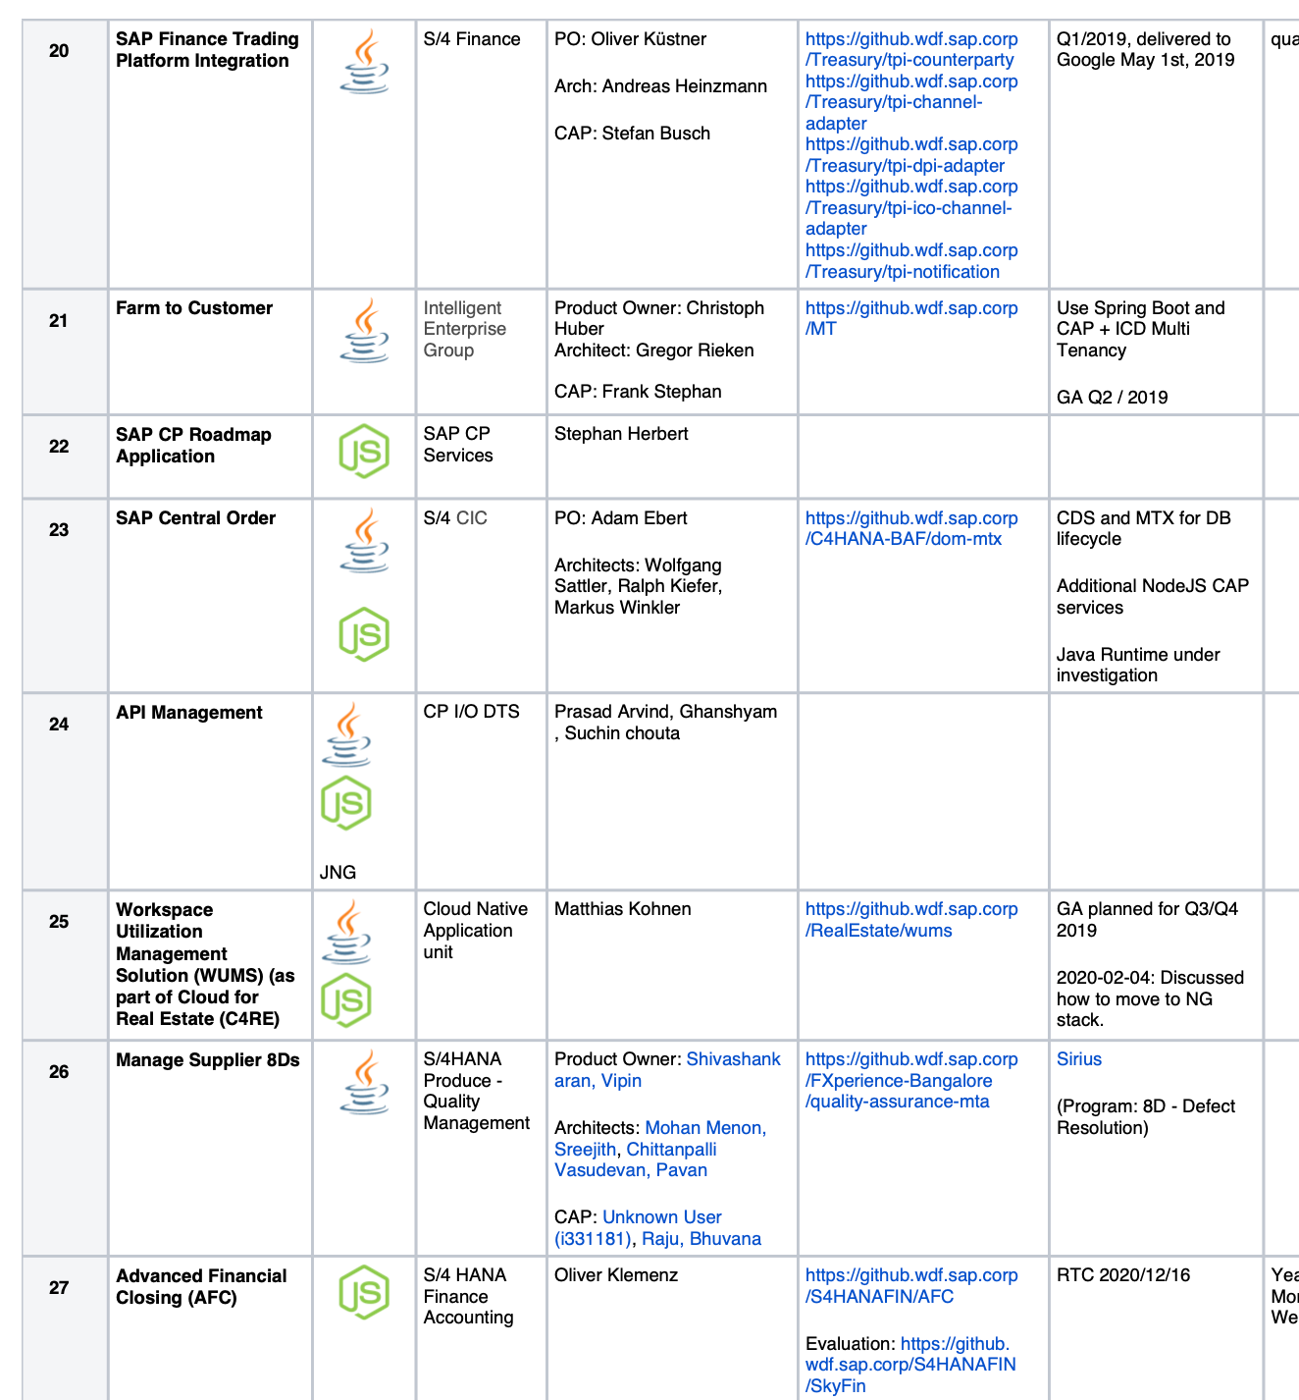
BTP CAP – SAP 제품 개발
SAP Standard 기능들이 BTP에서 개발되어 SaaS 서비스로 제공되고 있습니다.
SAP ERP를 위한 BTP 서비스
Financial Consolidation / Group Reporting Data Collection
SAP Finance Trading Platform Integration
SAP Central Order
Manage Supplier 8Ds
Advanced Financial Closing (AFC)
S/4 Procurement Planning
Credit Management
Resource Management
OneProcurement
S/4 Central Invoice Management
Partner Test Application
GRC Platform
Asset Performance Management
Product Footprint Management for Clean Operations
S/4HANA Sustainability Management
Release Assessment and Scope Dependency Tool

Slide 9
CAP Core Concepts

Slide 10
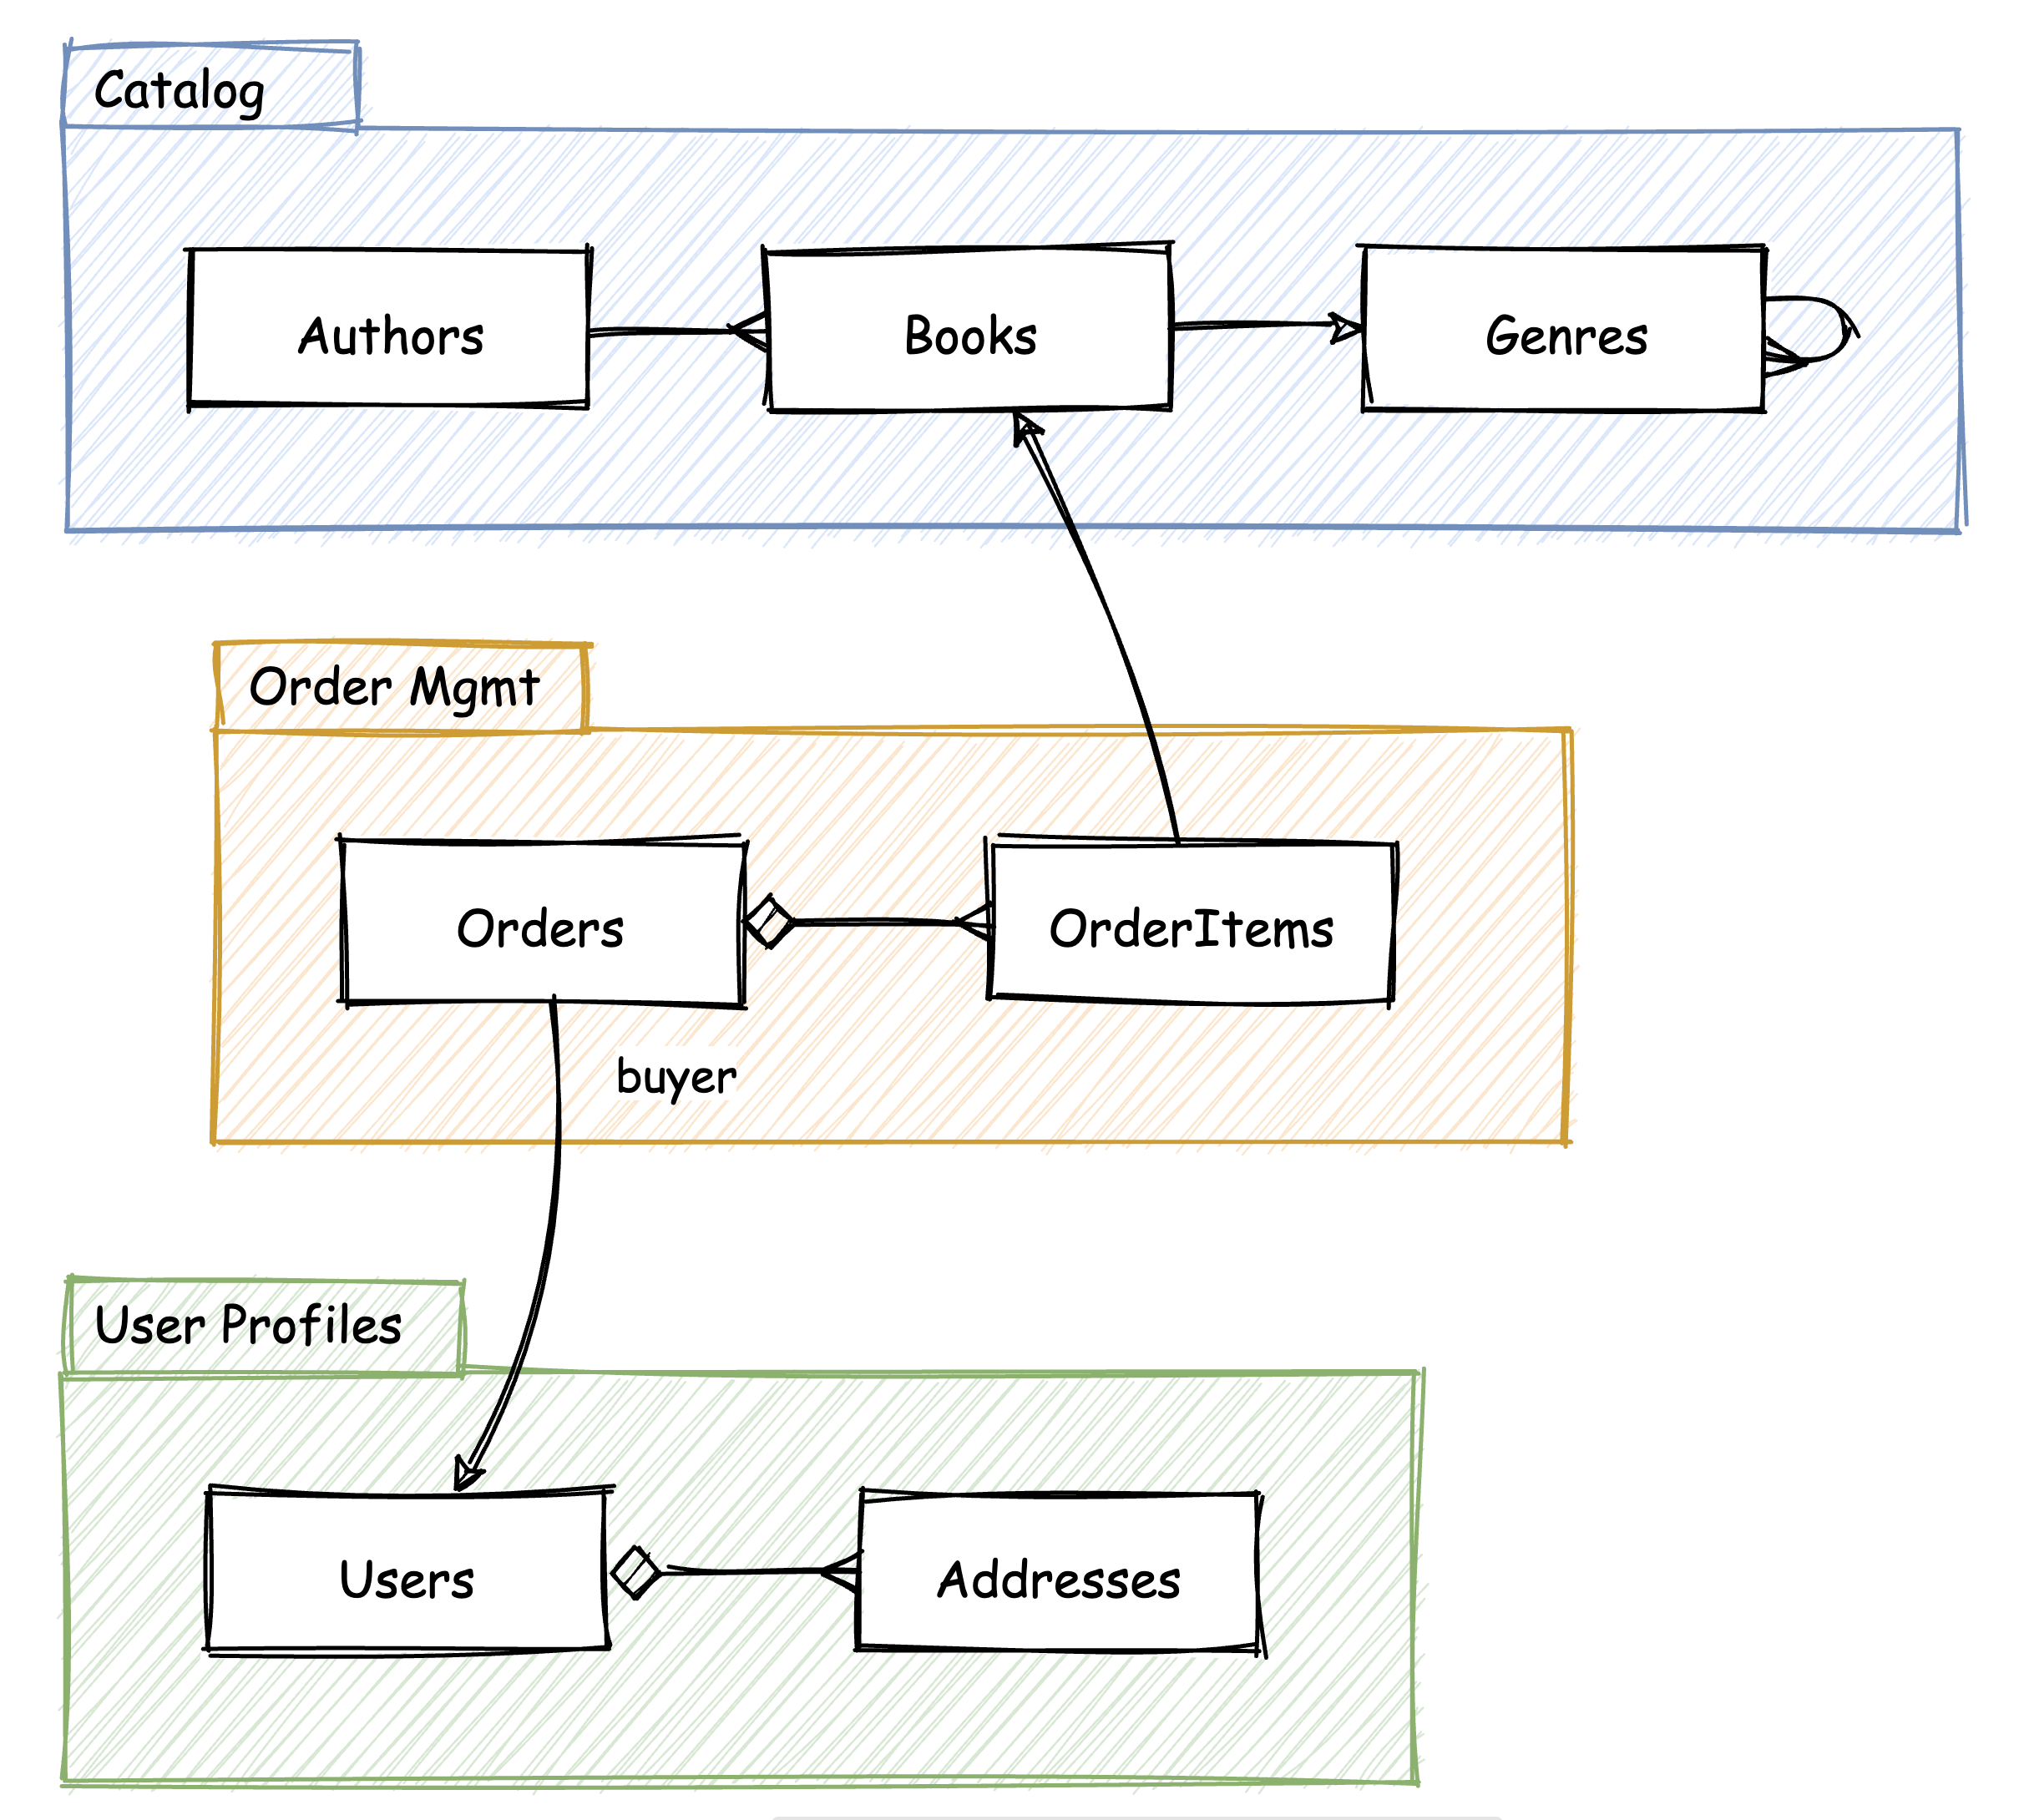
BTP 개발 프레임워크 – CAP > Domain Modeling
도메인 모델링 정의 & 개발에 집중.
Low-level tech → SAP CAP

Slide 11
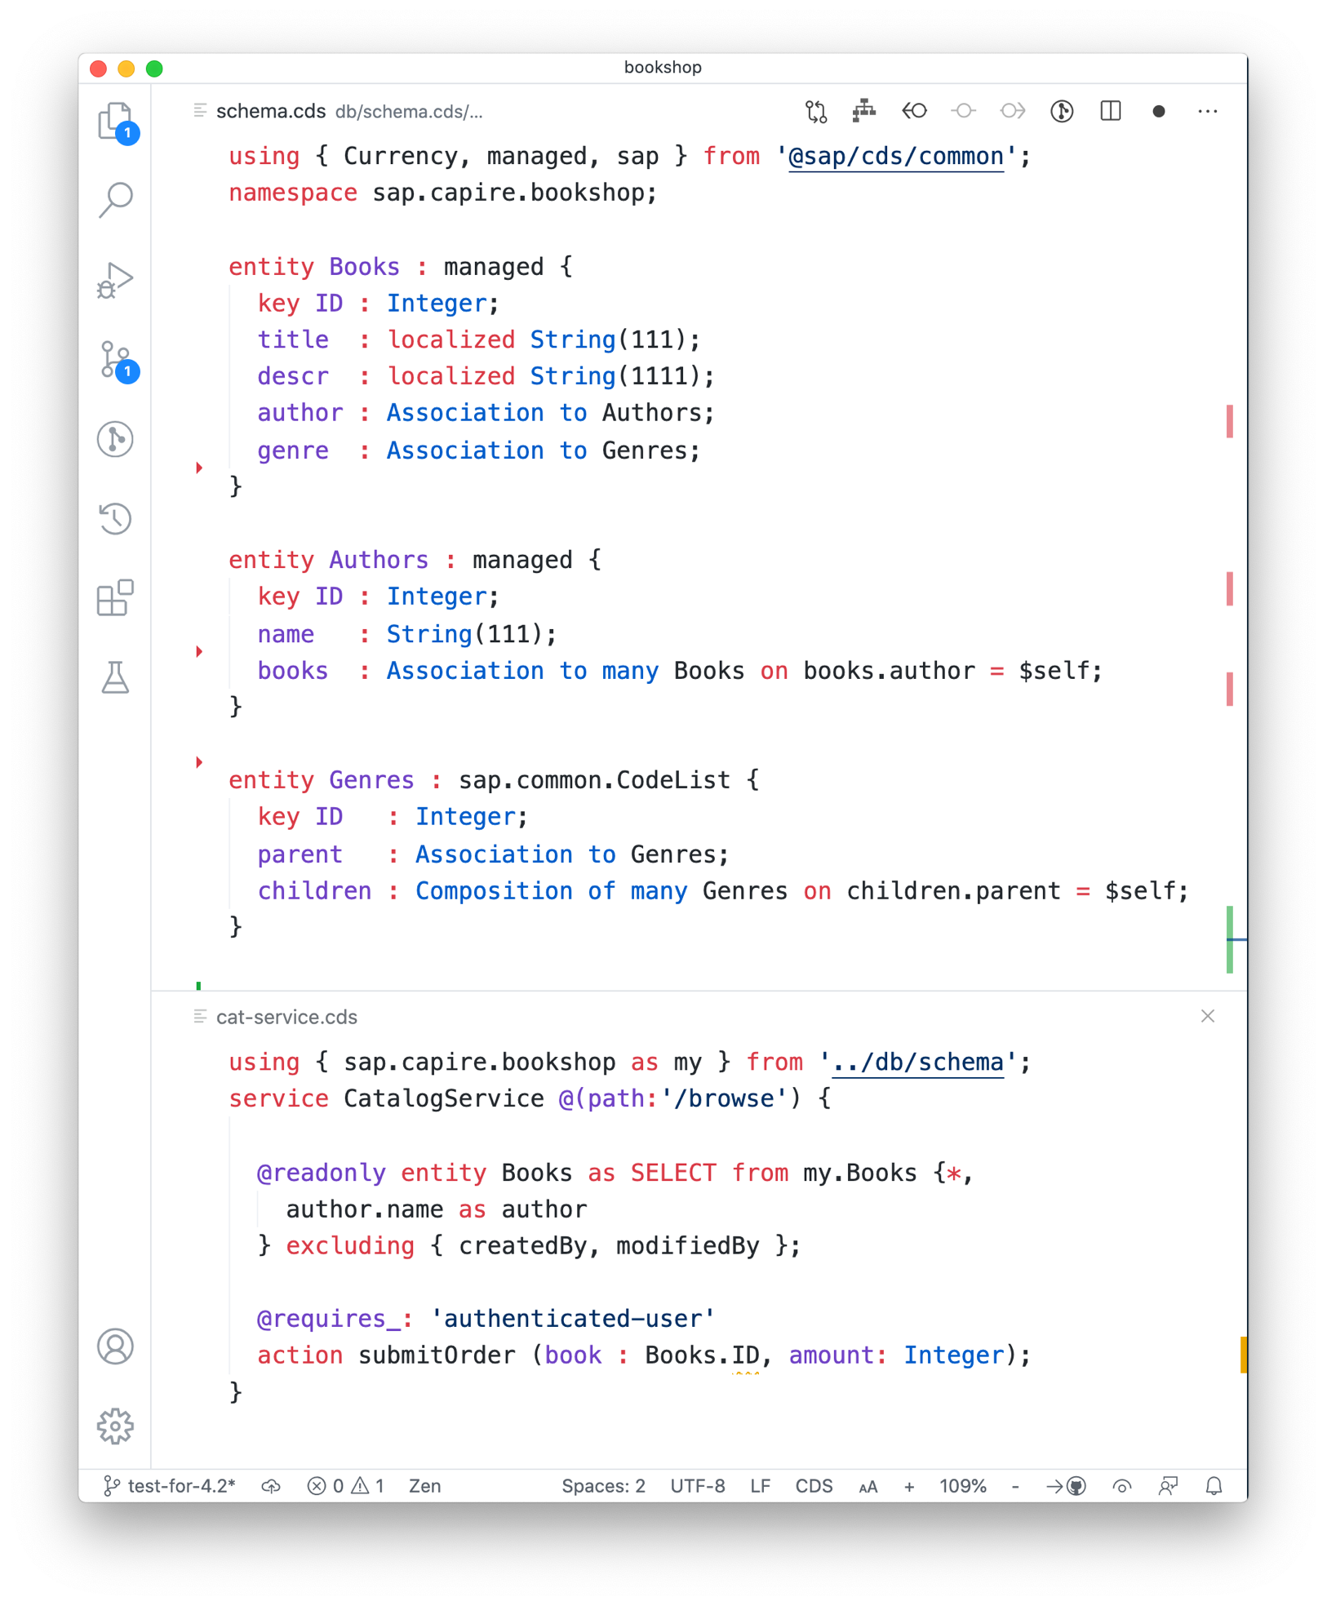
BTP 개발 프레임워크 – CAP > Domain Modeling
Conceptual Modelling Language
Entities & Views → SQL 기반
Associations → 관계 표현
Aspects → 공통 영역 정의 및 확장
Annotations → semantically 다양한 의미로 해석
Core Schema Notation (CSN) 기능
Generic Runtimes 과 자연스러운 연계
Domain Models
⇒ Domain-Driven Design: developers 과 domain experts 간 밀접한 협업 가능.
Service Models

Slide 12

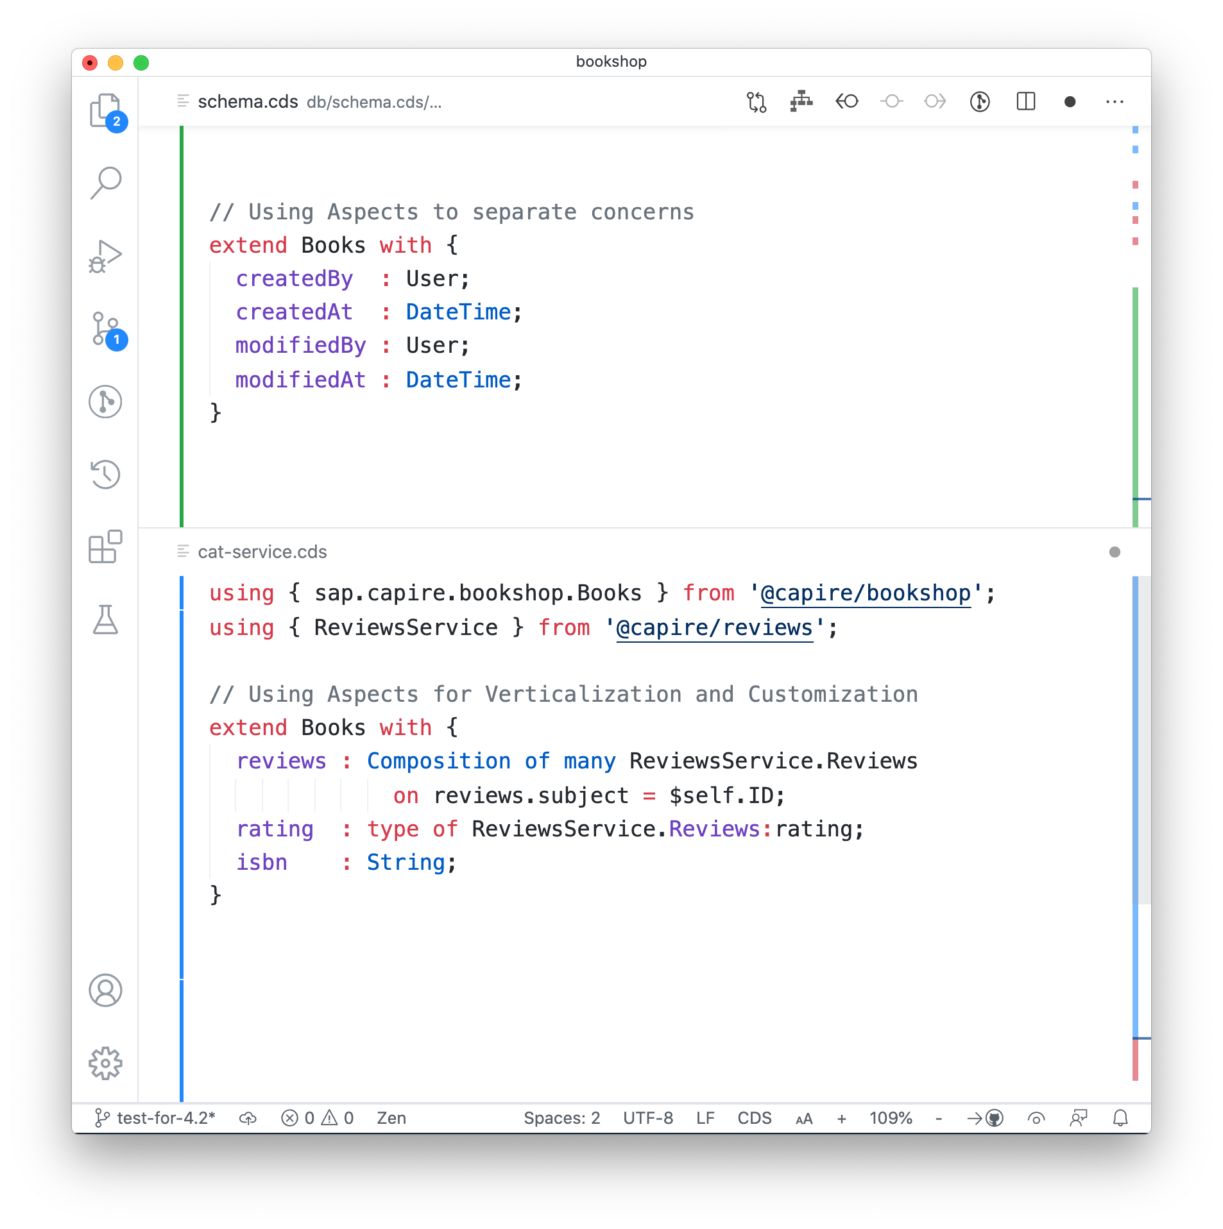
BTP 개발 프레임워크 – CAP > Domain Modeling
Conceptual Modelling Language
Entities & Views → borrowed from SQL
Associations → capture relationships
Aspects → separate concerns & extend
Annotations → enrich semantically
Based on Core Schema Notation (CSN)
Fueling Generic Runtimes
⇒ Separating technical concerns : domain models 을 간결하고 이해하기 쉽게 유지

Slide 13
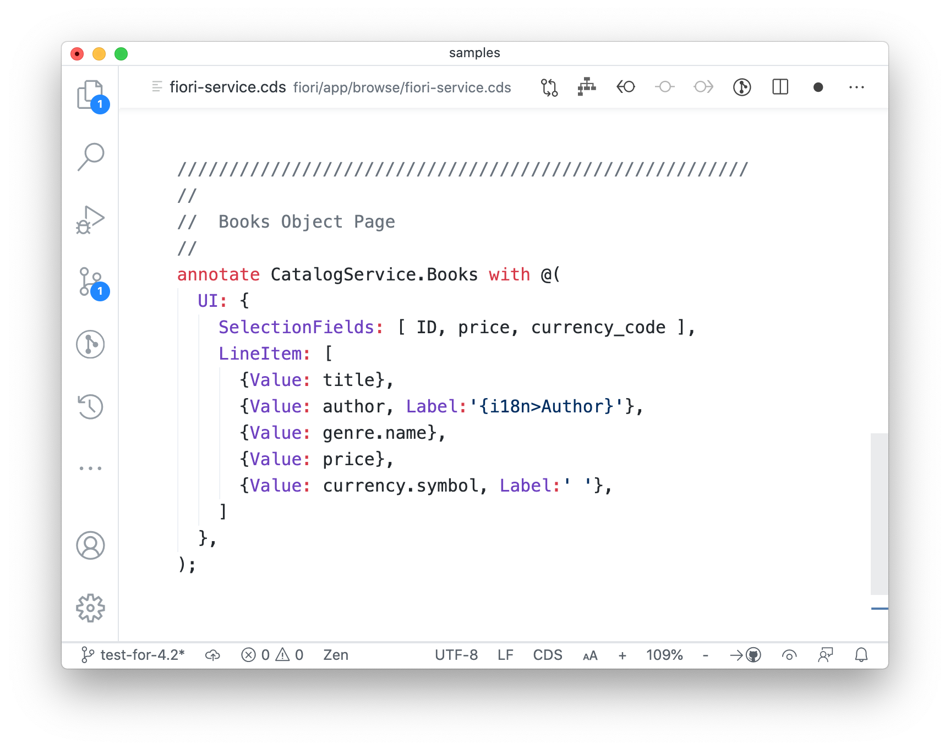
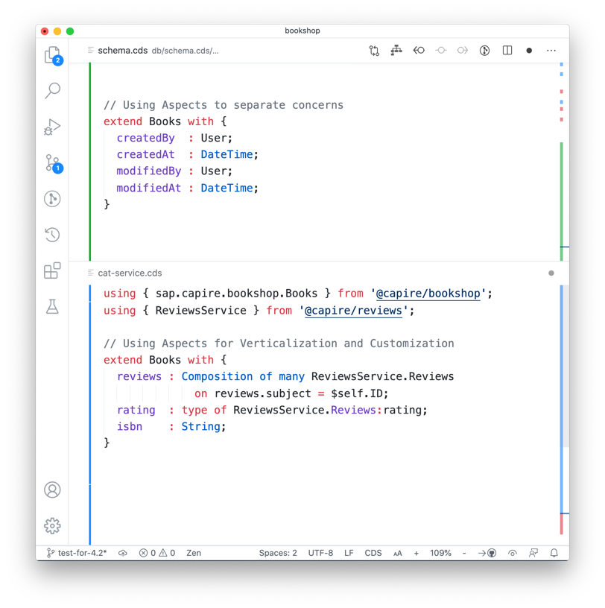
BTP 개발 프레임워크 – CAP > Domain Modeling
Conceptual Modelling Language
Entities & Views → borrowed from SQL
Associations → capture relationships
Aspects → separate concerns & extend
Annotations → enrich semantically
Based on Core Schema Notation (CSN)
Fueling Generic Runtimes
⇒ Frontend-specific Annotations: e.g. for Workflows, Analytics or UI Markup

Slide 14








BTP 개발 프레임워크 – CAP > Domain Modeling
Conceptual Modelling Language
Entities & Views → borrowed from SQL
Associations → capture relationships
Aspects → separate concerns & extend
Annotations → enrich semantically
Based on Core Schema Notation (CSN)
Fueling Generic Runtimes
Textual Sources
Target Outputs
.cds
parse
OData
.json
SQL
.yaml
HANA
{ csn }
.json
Other Sources
.yaml
Marketplaces
.cds
Modelers
• • •
Other
⇒ Open, extensible design: 모든 사람들이 쉽게 CDS 모델링을 생성하고 확장해 나갈 수 있음.

Slide 15
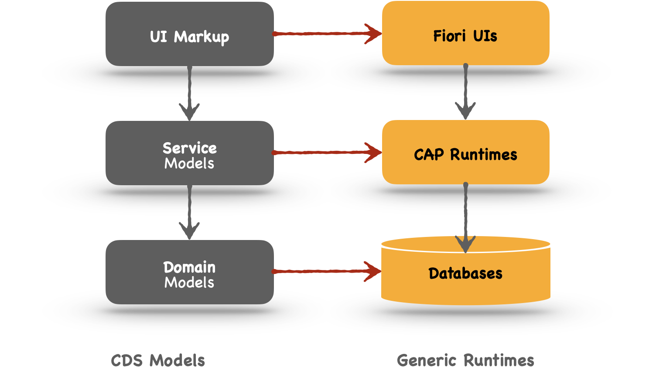
BTP 개발 프레임워크 – CAP > Domain Modeling
Conceptual Modelling Language
Entities & Views → borrowed from SQL
Associations → capture relationships
Aspects → separate concerns & extend
Annotations → enrich semantically
Based on Core Schema Notation (CSN)
Fueling Generic Runtimes
⇒ Capture intent declaratively: Design time을 Runtime 모드로 자연스럽게 변환시켜 필요한 오브젝트들을 생성

Slide 16





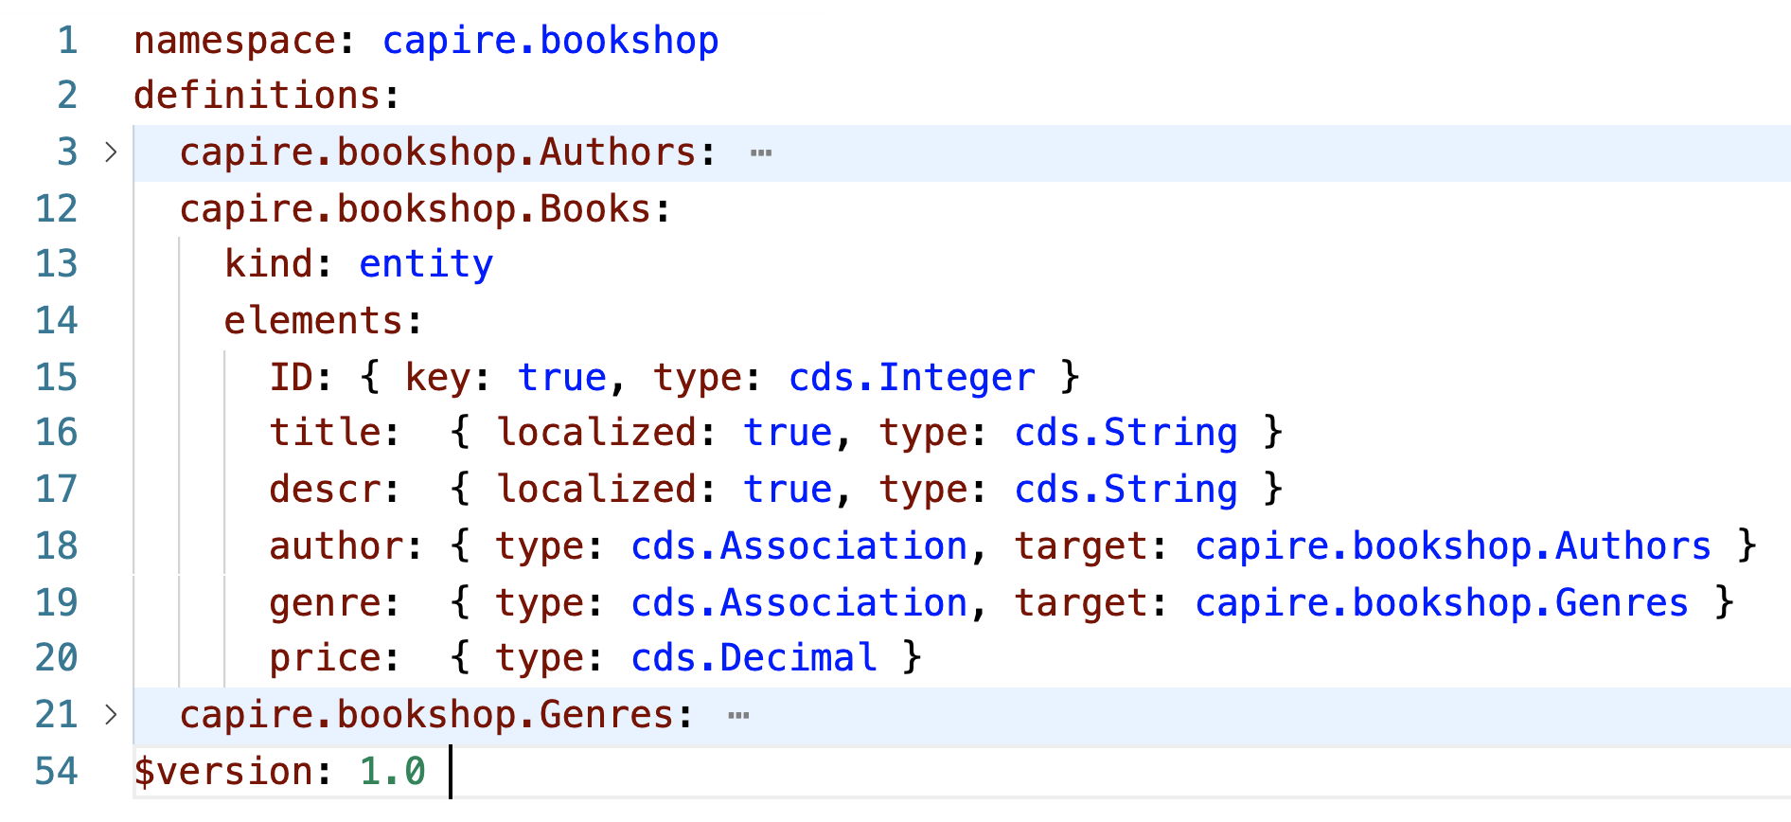

BTP 개발 프레임워크 – CAP > Domain Modeling
Core Schema Notation (CSN)
Textual Sources
Output Formats
❺ Based on Core Schema Notation, a plain object notation and JSON Schema derivate
⇨ Open Ecosystem easy to create, reflect and process models
⇨ Interoperability through adoption and support in various stacks and products
⇨ Lingua Franca e.g. for domain models, APIs, mappings, extensions, …
parse ➟
.cds
OData, OpenAPI, …
{ csn }
compile to ➟
.json
SQL, HANA
construct ➟
.yaml
.json / .yaml
Other Sources
.cds
Marketplaces
Modelers
Apps

Slide 17
BTP 개발 프레임워크 – CAP > Service-centric Paradigm
Everything is a Service
Every active thing in CAP is a Service…
always stateless, acting on passive data → scalability
reflecting individual use cases → ‘nano services’
acting as facades for consumers to access data
including technical/framework services in CAP
exchanging messages via uniform APIs
synchronously as well as asynchronously
locally as well as remotely (via proxies) …
Service
Catalog Service
// declaring a service provided by us
service CatalogService {
entity Books …
action addToBasket (...)
}
⇒ 확장에 용이한 stateless 구조이며, 오직 데이타 처리에만 반응하는 pure function을 지원.(복잡하지 않은 내부 구조)

Slide 18
BTP 개발 프레임워크 – CAP > Service-centric Paradigm
Single-purposed Services
Every active thing in CAP is a Service…
always stateless, acting on passive data → scalability
reflecting individual use cases → ‘nano services’
acting as facades for consumers to access data
including technical/framework services in CAP
exchanging messages via uniform APIs
synchronously as well as asynchronously
locally as well as remotely (via proxies) …
Catalog Service
Admin Service
// for end users to browse and shop books…
service CatalogService {
entity Books as projection on my.Books;
action addToBasket (...)
}
// for admins to maintain everything ...
service AdminService @(requires:'admin’) {
entity Books { ... }
entity Authors { ... }
}
⇒ Modularize w/ ‘Nano’ Services use case별로 나눠서 서비스 그룹 생성.

Slide 19

BTP 개발 프레임워크 – CAP > Service-centric Paradigm
Services as Facades
Consumers
Every active thing in CAP is a Service…
always stateless, acting on passive data → scalability
reflecting individual use cases → ‘nano services’
acting as facades for consumers to access data
including technical/framework services in CAP
exchanging messages via uniform APIs
synchronously as well as asynchronously
locally as well as remotely (via proxies) …
Catalog Service
Admin Service
// some consumer code…
const cats = cds.connect.to ('CatalogService')
let books = await cats.read ('Books’)
for (let book of books)
if (’→ like it? ') cats .addToBasket (book)
Database
⇒ UI Applications(Consumers)들은 제한적으로 노출된 APIs활용

Slide 20
BTP 개발 프레임워크 – CAP > Service-centric Paradigm
eating our own dog food
Custom-defined
Every active thing in CAP is a Service…
always stateless, acting on passive data → scalability
reflecting individual use cases → ‘nano services’
acting as facades for consumers to access data
including technical/framework services in CAP
exchanging messages via uniform APIs
synchronously as well as asynchronously
locally as well as remotely (via proxies) …
Catalog Service
Custom DB
Admin Service
SQLite
CAP-builtin
Messaging
HANA
// Using CAP’s database and messaging services…
const db = cds.connect.to (‘sqlite:in-memory')
const msg = cds.connect.to (‘messaging')
let books = await db.read ('Books’)
msg.emit (‘like’, { that: book })
MTX
⇒ Modularity를 통해 서비스 재사용.
다양한 외부 서비스와의 연계를 위한 plug in 서비스 제공

Slide 21
BTP 개발 프레임워크 – CAP > Service-centric Paradigm
Uniform APIs
Every active thing in CAP is a Service…
always stateless, acting on passive data → scalability
reflecting individual use cases → ‘nano services’
acting as facades for consumers to access data
including technical/framework services in CAP
exchanging messages via uniform APIs
synchronously as well as asynchronously
locally as well as remotely (via proxies) …
Catalog Service
Admin Service
Custom DB
Messaging
Database
// consuming services, including own provided ones …
let books = await CatService .read ('Books’) // CRUD style
let books = await CatService .get (‘/Books’) // REST style
// implementing provided services…
CatService .on (‘READ’, 'Books’, (req)=>{ … })
// intercepting consumed services…
db .on (‘READ’, ‘*’, (req)=>{ … })
⇒ All services support common APIs (OData CRUD style, REST style) to consume and implement services

